Slide 1

Vel Tech Rangarajan Dr. Sagunthala R&D Institute of Science and Technology
School of Computing
Department of Computer Science and Engineering
10211CS224 / FULL STACK APPLICATION DEVELOPMENT
END SEMESTER PROJECT REVIEW
EVENTSYS: A DYNAMIC CAMPUS EVENT MANAGEMENT AND SMART TICKETING PLATFORM
06/05/2026
SDG: 9 – Industry , Innovation and Infrastructure
SDG: 12- Responsible Consumption and Production
Presented By:
N.LIKHITHA KUMARI – VTU26510 – 23UECS0823
Courses Handling Faculty:
Dr. S. Hemamalini, Assistant.Professor
(Sr Grade)-M.E,ph.D

Slide 2
INTRODUCTION
1
The management of campus events in many institutions is often handled manually, leading to issues such as poor coordination, ticket mismanagement, and lack of real-time updates. This creates inconvenience for both organizers and participants. Hence, there is a need for a centralized digital system to streamline event operations. The proposed project, EVENTSYS, addresses these challenges by providing an efficient platform for event creation, ticket booking, and management. It is important as it enhances user experience, reduces manual effort, and ensures accurate record maintenance. In real-world scenarios, such systems are widely used in universities, conferences, and large-scale events. EVENTSYS is a dynamic web-based application that enables users to browse events, book tickets, and receive instant confirmations, while administrators can manage events and monitor bookings effectively.
2
3
4
5
6
7
8
9

Slide 3
PROBLEM STATEMENT
1
The management of campus events is often carried out using manual or semi-digital methods, which leads to inefficiencies such as data inconsistency, poor coordination, and lack of transparency. Participants face difficulties in accessing event information and booking tickets, while organizers struggle with tracking registrations and managing resources. The absence of a centralized system results in delays, errors, and communication gaps. Additionally, there is no proper mechanism for real-time updates or automated confirmations. This creates inconvenience for both users and administrators. Therefore, there is a need for a reliable and integrated platform that can streamline event management and ticketing processes efficiently.
2
3
4
5
6
7
8
9

Slide 4
OBJECTIVE(S)
1
2
.
Develop a centralized platform to manage campus events efficiently
Enable users to view events, book tickets, and get instant confirmations
Provide admins with tools to create, update, and monitor events
3
4
5
6
7
8
9

Slide 5
PROPOSED SYSTEM
1
Provides a centralized web platform for managing all campus events
Allows users to easily browse events and book tickets online Enables real-time updates on event
details and ticket availability Automates booking confirmation through instant notifications
Reduces manual errors and improves data accuracy
Simplifies event management for administrators with a dedicated dashboard
Enhances user experience with a smooth and interactive interface
More efficient and cost-effective compared to traditional/manual systems
2
3
4
5
6
7
8
9

Slide 6
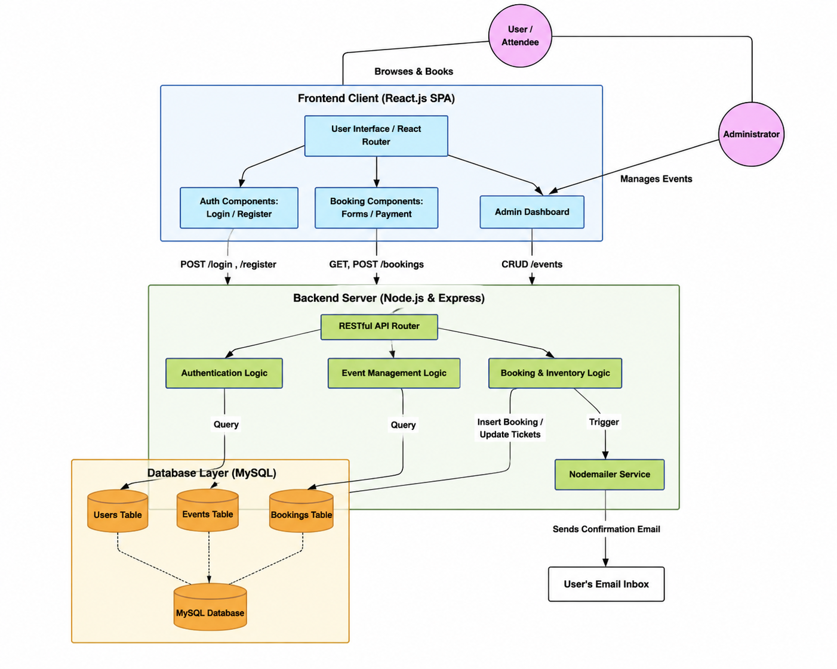
PROPOSED SYSTEM ARCHITECTURE
1
2
3
4
5
6
7
8
9

Slide 7
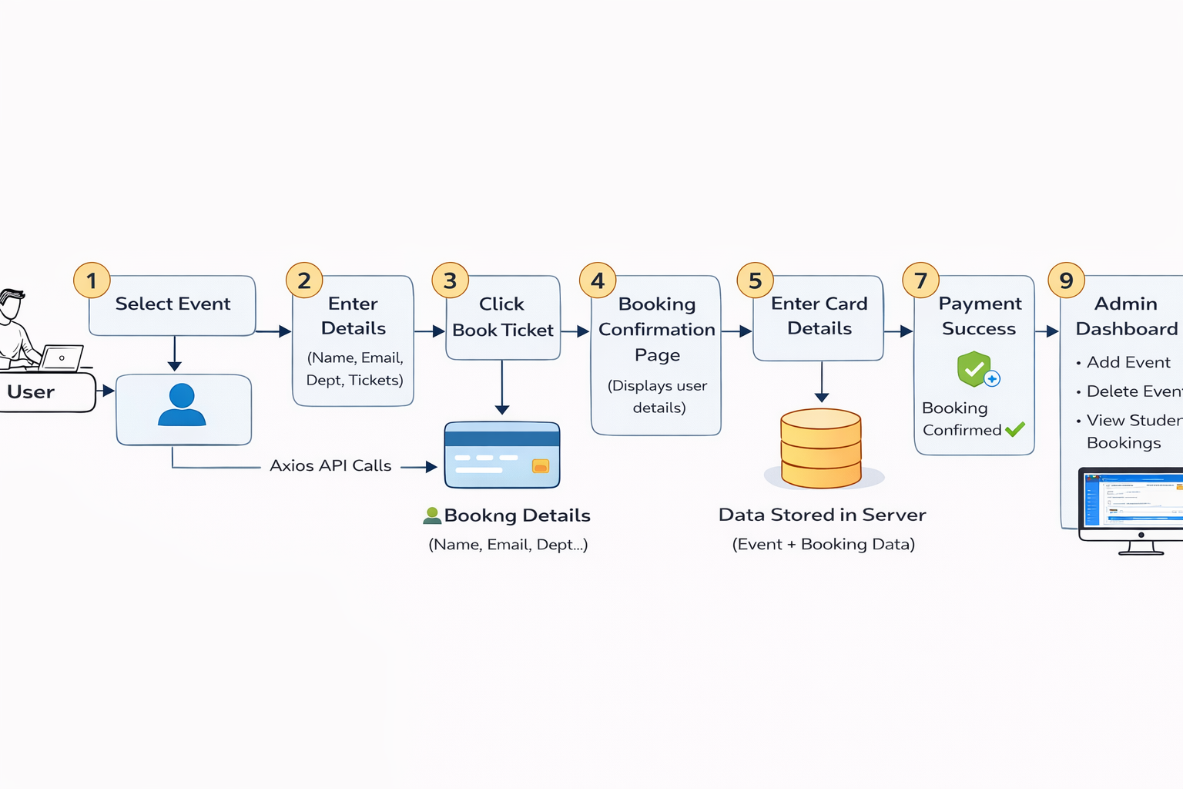
WORKFLOW
1
2
3
4
5
6
7
8
9

Slide 8
TECHNOLOGIES USED
Frontend: React.js, HTML, CSS, JavaScript
Backend: Node.js, Express.js
Database: MySQL/H2 Console
Third-Party API: Nodemailer (for email notifications)
Tools: VS Code
Hardware/Software Requirements: Intel i3 or above, 4GB RAM (minimum), Windows, Web Browser (Chrome), Node.js installed
1
2
3
4
5
6
7
8
9

Slide 9
MODULE DESCRIPTION
Module 1 – User Booking
Select event
Enter details
Book ticket
Module 2 – Confirmation
Displays user details
Shows event info
Proceed to payment
Module 3 – Payment
Enter card details
Simulated payment
Booking confirmation alert
Module 4 – Admin Panel
Add event
Delete event
View bookings
1
2
3
4
5
6
7
8
9

Slide 10
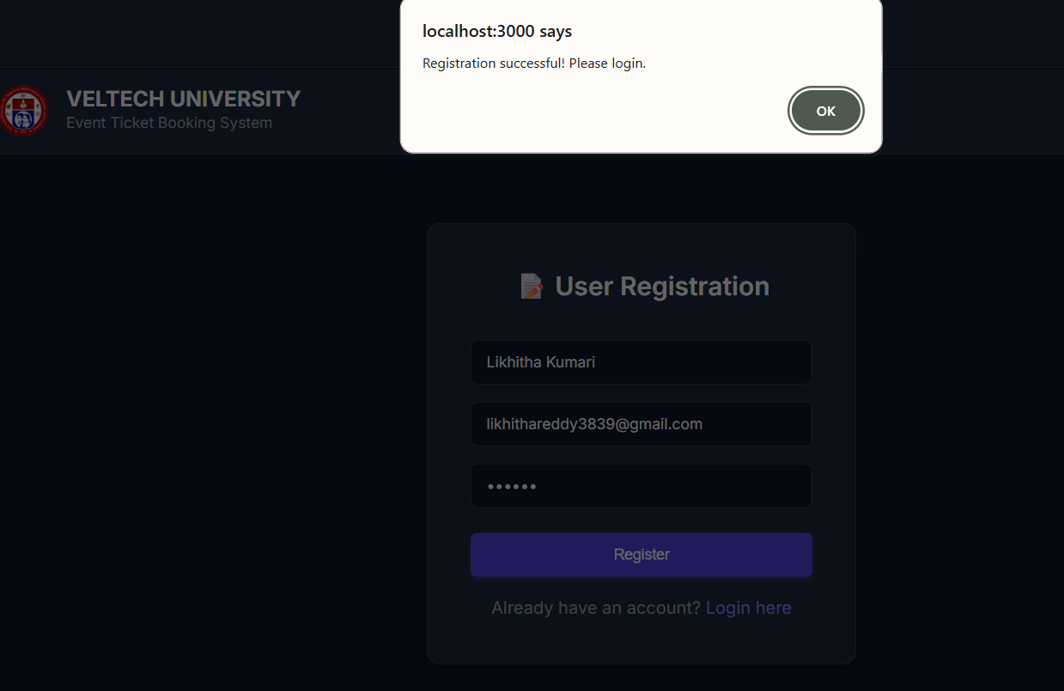
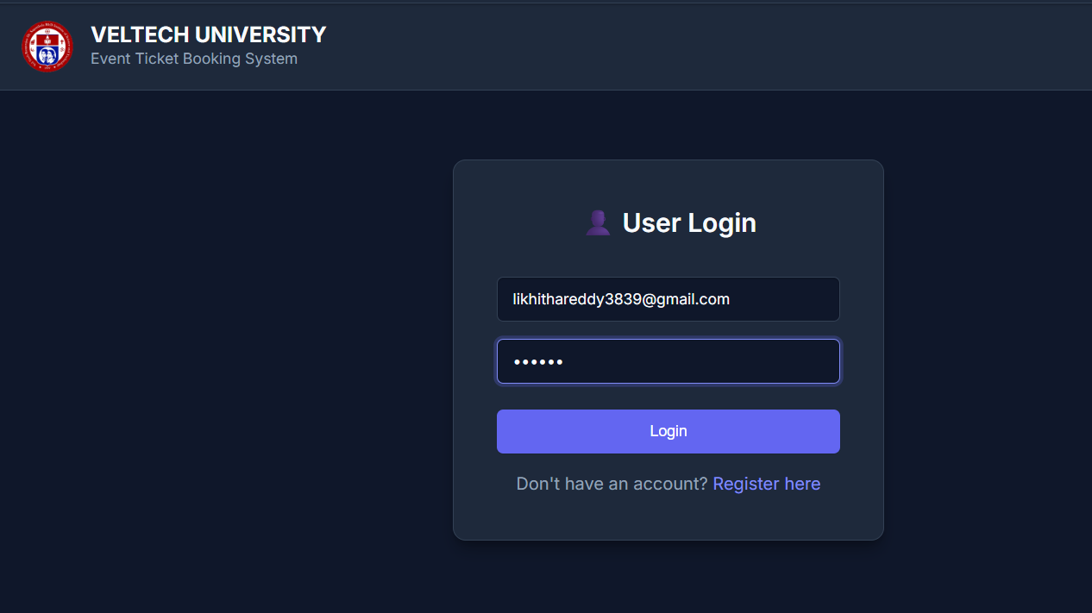
IMPLEMENTATION SCREENSHOTS
1
2
3
4
5
6
Figure : User Login Page
7
8
9
Figure : User Registration Page

Slide 11
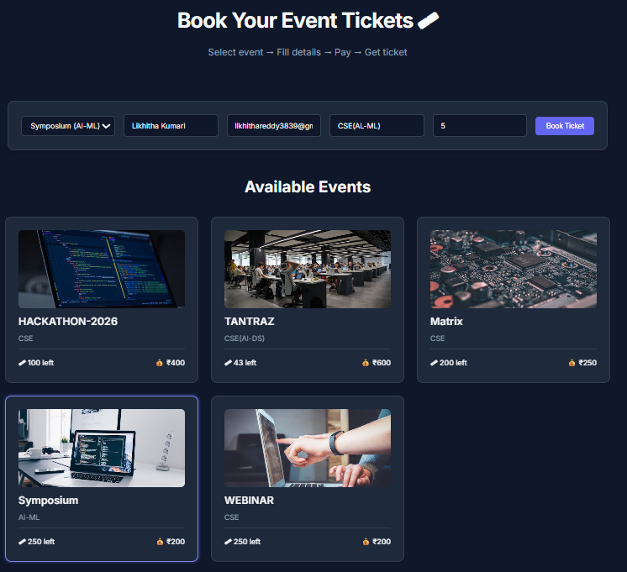
IMPLEMENTATION SCREENSHOTS
1
2
3
4
5
6
7
8(A)
9
Figure : Event Booking Interface

Slide 12
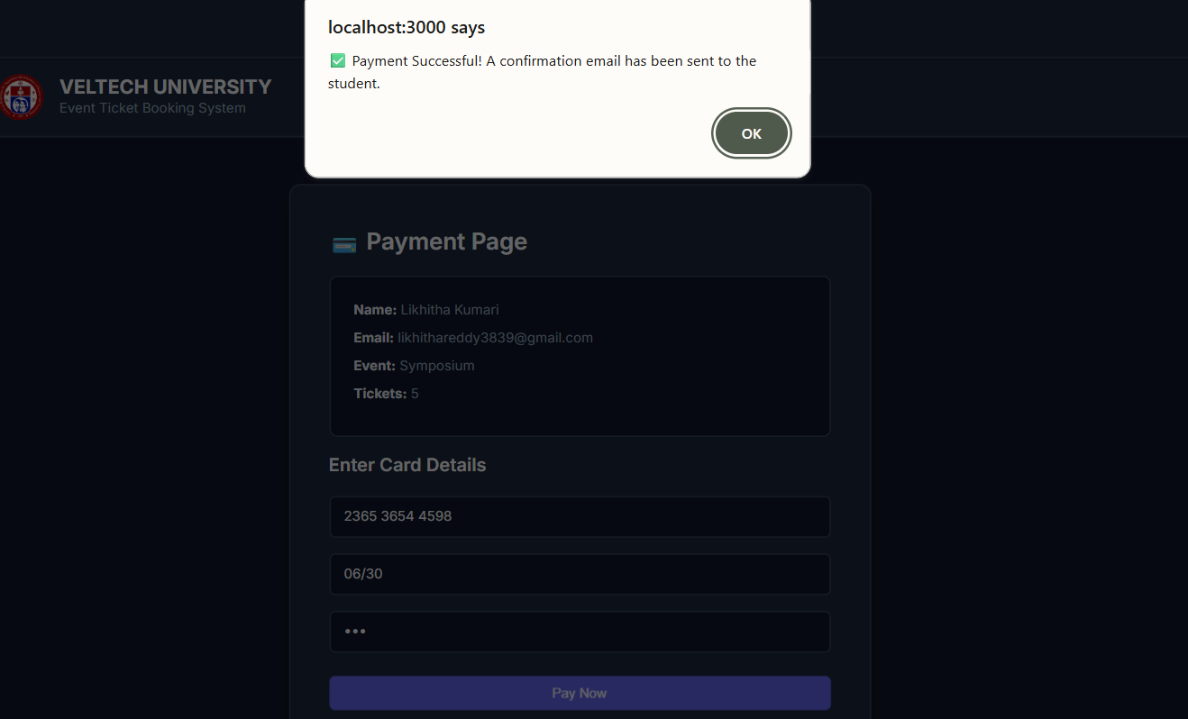
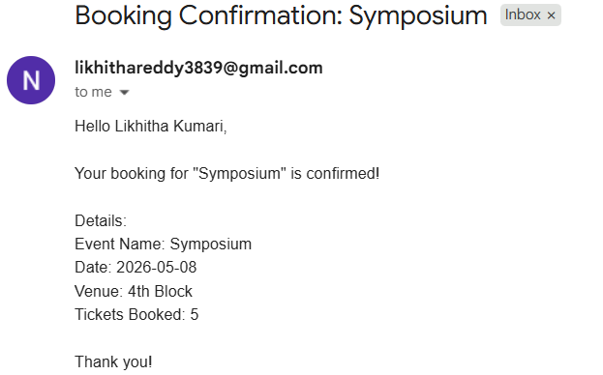
IMPLEMENTATION SCREENSHOTS
1
2
3
4
5
6
7
Figure : Payment Page
8(B)
9
Figure : Booking Confirmation Email

Slide 13
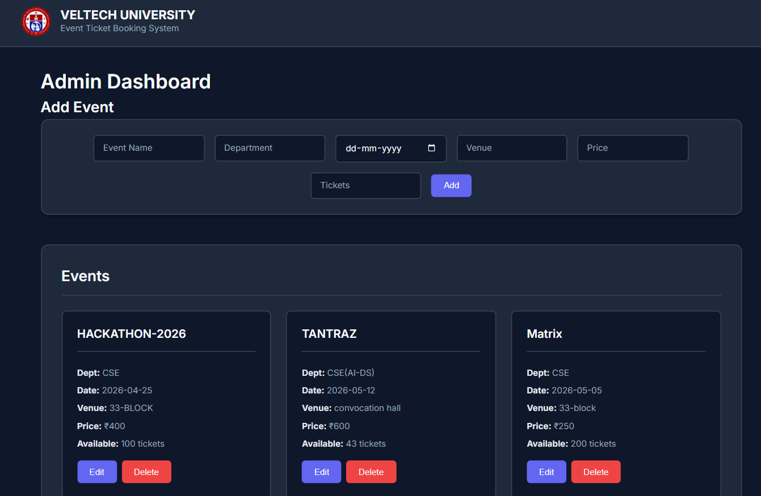
IMPLEMENTATION SCREENSHOTS
1
2
3
4
5
6
7
8(C)
9

Slide 14
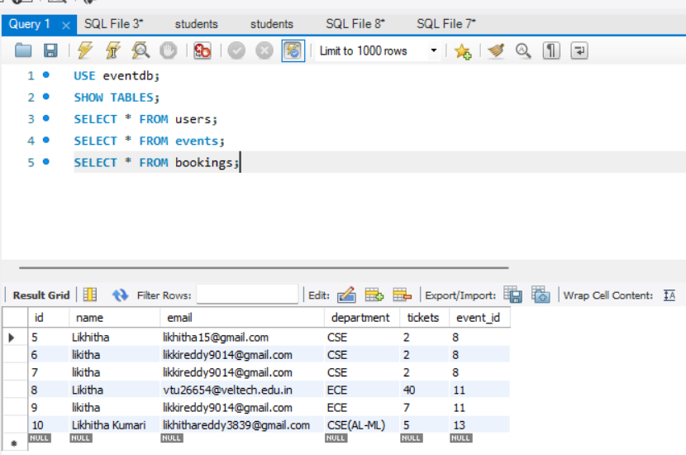
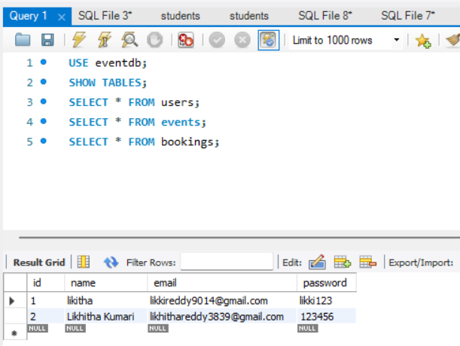
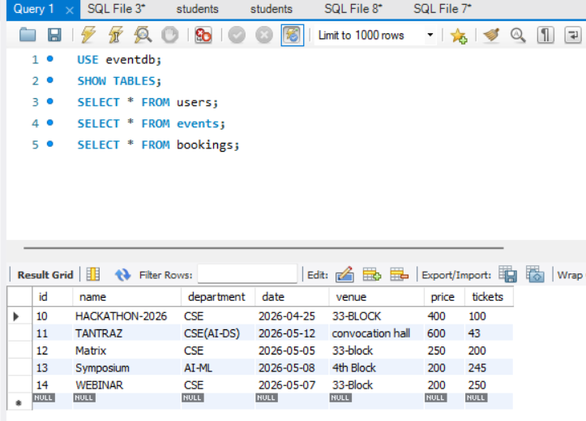
IMPLEMENTATION SCREENSHOTS
1
2
3
4
5
6
7
8(C)
9

Slide 15
ADVANTAGES & LIMITATIONS
1
Advantages:
Limitations:
No real payment gateway
No database
Single admin system
No authentication security
2
Easy ticket booking
Centralized system
Admin control
Real-time event display
Simple UI
3
4
5
6
7
8
9

Slide 16
Thank you

